Slide 1
Pens and Printers
Data Analysis of New Products Revenue
First Six Weeks

Slide 2
Business Goals
Analyze data for the first six weeks of sales from the new product line.
Determine the effectiveness of three different methods of customer interaction with regards to the new product line.
Provide recommendations for use of these methods going forward, including a metric on how to define success.

Slide 3
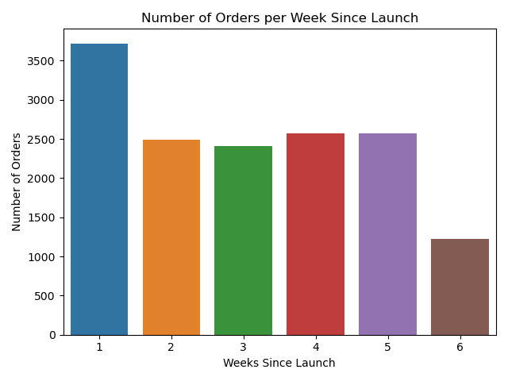
The number of orders received from the new product line was largest in the first week.
Then, orders were fairly steady for the next four weeks.
In the sixth week of the campaign, orders fell by more than ½.
Notes:
The number of orders received from the new product line was highest in the first week, around 3600 orders. The next four weeks were fairly consistent at around 2500 orders per week. In the sixth week, the number of orders fell to about half of the previous four weeks. So that seems the like campaign had lost some steam. But . . .

Slide 4
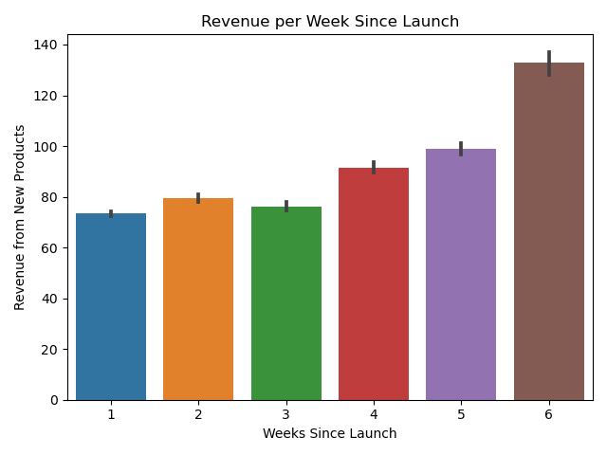
Revenue generally grew over the six weeks of the campaign, the opposite of the number of orders.
Notes:
Revenue generally grew each week during the six weeks. So that is positive news and indicates that customers were buying more or more expensive items later in the campaign.

Slide 5
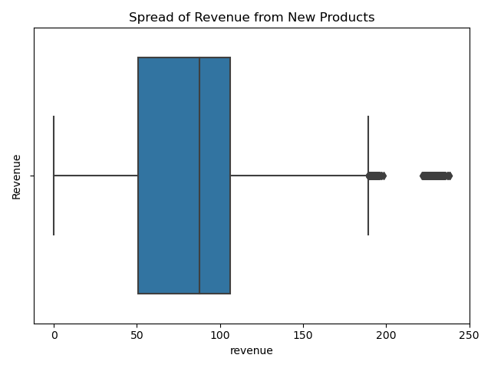
50% of the revenue per customer from the new products was in the $50 to $100 range.
Another 25% of the revenue was spread out between $100 and $200 worth of purchases.
There were a few outlier customers who purchased more than $200 from the new product line.
Average revenue per customer on the new product line is $87.22. Median is $87.58.
Notes:
Let’s look at the distribution of revenue per customer for the six weeks. 50% of the revenue per customer from the new products was in the $50 to $100 range.
Another 25% of the revenue was spread out between $100 and $200 worth of purchases.
There were a few outlier customers who purchased more than $200 from the new product line.
About 8% of our total customers did not buy anything from the new product line.
Average revenue per customer on the new product line is $87.22.

Slide 6
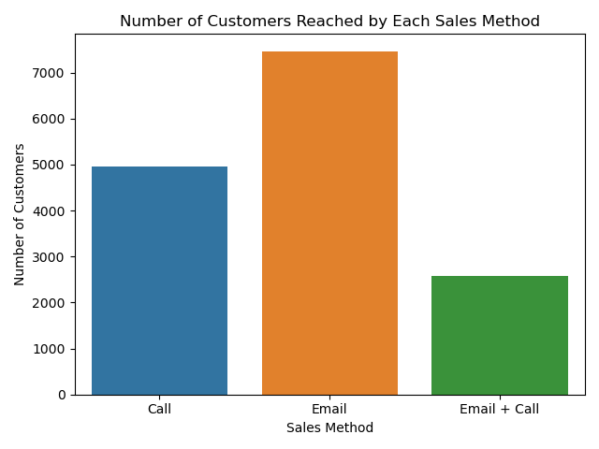
7465
Email alone reached the most customers, 7465. Of the three methods, ‘email only’ took the least amount of time from the Sales Team per customer.
Calls alone reached around 5000 customers, with each one taking about 30 minutes per customer.
Email plus a follow-up call, reached the fewest number of customers with a total time spent by the Sales Team of around 10 minutes per customer.
4962
2572
Notes:
So we know that revenue grew as the campaign progressed and most of the revenue was in the $50 to $100 range. What about the different sales methods? How did they impact orders and revenue? The number of customers reached for each sales method show that email alone reached the most customers, followed by calls alone and finally, email + calls. But just reaching customers is not the goal. Getting them to buy from the new product line is the goal.

Slide 7
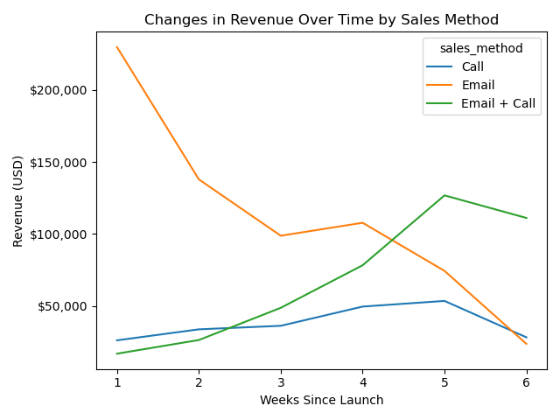
Email generated the most revenue for the first four weeks.
Calls by themselves generated less than $50,000 of revenue for all six weeks.
Email plus a follow-up call impacted revenue in the last two weeks as the effects of ‘email only’ wore off.
Notes:
Email generated the most revenue for the first four and a half weeks but after that the method of email plus a phone call generated better results. The email + phone call method picked up in week 2 and then generated the most revenue for the last 2 ½ weeks. Calls by themselves generated less than $50,000 worth of revenue each week and took a lot more time from the sales team.
In summary, customers bought more products using the email method early in the campaign and more from the email plus phone call method later in the campaign.

Slide 8
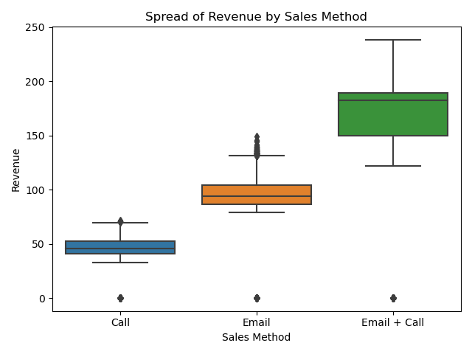
Notes:
So what impact did the different methods have on the amount per order? This chart clearly shows that the combination of an initial email and a follow-up call resulted in the more revenue per order. The median sale for this type of customer contact was $182. While email alone produced a median of about $94 of sales and a call alone only produced around $45 in sales.

Slide 9
Recommendations
Eliminate the 'Call only’ option when rolling out new products.
Use Average Revenue per Customer as an ongoing metric to track sales. Increasing the average revenue per customer from $87.22 would indicate success.
Fix errors in years_as_customer.
Notes:
Based on the data, my recommendations include: Eliminate the 'Call' only option when rolling out new products. This option is less effective than an email alone or an email plus a follow-up call. Sales personnel should concentrate on more productive and less time intensive options than calls only.
Use Average Revenue per Customer as an ongoing metric. The current average revenue per customer is $87.22 so anything higher than that would indicate success.
Years_as_customer was not helpful in this analysis but I did find two errors in the data. One customer is listed as being a customer for 47 years and another for 63 years. Since the company has only been in business for 39 years, those data points are impossible. The values should be corrected.

Slide 10
Other Information for Analysis
Which kinds of new products are generating the most revenue?
Who are the businesses that are spending more than $100 on new products?
Can we target more of those types of businesses?
What kinds of products are our best customers purchasing?
How do the new products contribute to the overall profitability of the company?
How do they compare with previous products' revenue?
Notes:
Some other information that might be helpful to analyze the new product line includes:

